Slide 1
Impact of rezoning on socio-economic distribution in New York City
Performing a racial equity analysis to measure the change in diversity index over ten years in five such rezoned neighbourhoods and predicting the risk of gentrification in proposed neighbourhoods.
Notes:
Purpose of the study
Rezoning can act as an essential process in building neighbourhoods and inducing affordable housing and economic development. However, it is essential to study the impact of rezoning on the neighbourhood and ensure that it does not drive out longtime residents by making it unaffordable.
The scope of our study includes performing a racial equity analysis to measure the change in diversity index over ten years in five such rezoned neighbourhoods and predicting the risk of gentrification in proposed neighbourhoods. Through this analysis, we expect to anticipate how the new development would influence existing segregation patterns.

Slide 2
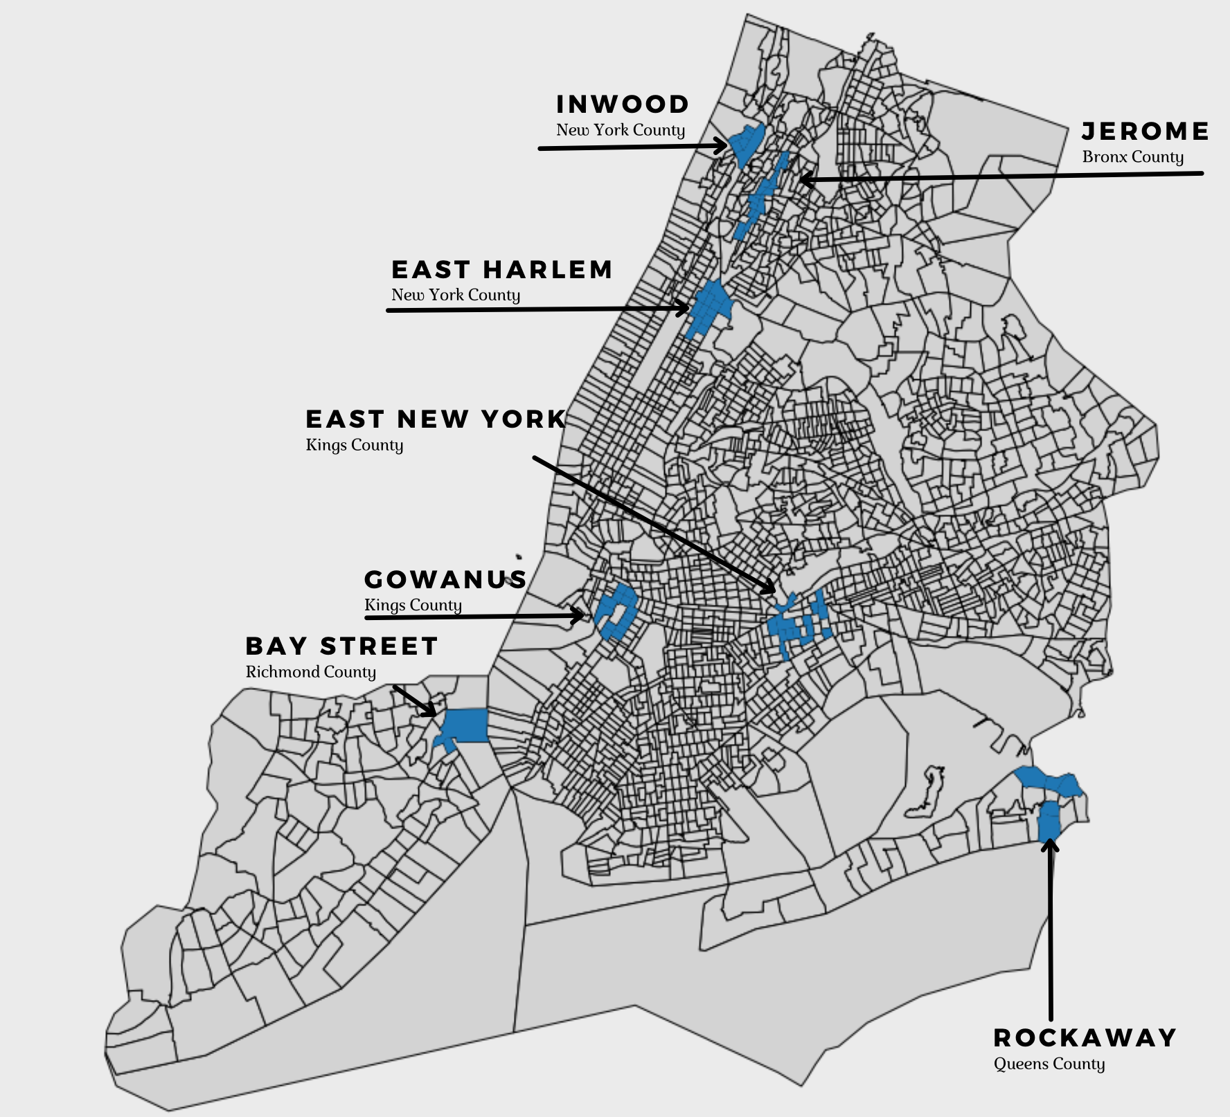
Intro and Scope
Rezoning:
Demographic shifts caused by rezoning
Measuring the risk of displacement in rezoned neighbourhoods
Data we are using:
American Community Survey (ACS):
Racial
Education
Income statistics
Notes:
1.Demographic shifts caused by rezoning:
a. Looking at neighbourhoods that have been rezoned
b. Looking at neighbourhoods in the midst of rezoning/considered for future rezoning
2. Measuring the risk of displacement in rezoned neighbourhoods disaggregated by race/ethnic group a. Evaluate the change in racial composition in the affected neighbourhoods over time
a. How rezoning has affected the lives of residents in the rezoned neighbourhoods outside of the findings readily available from the data
b. Has the city been successful at curbing racial segregation/displacement in the wake of rezoning with programs such as MIH and others

Slide 3
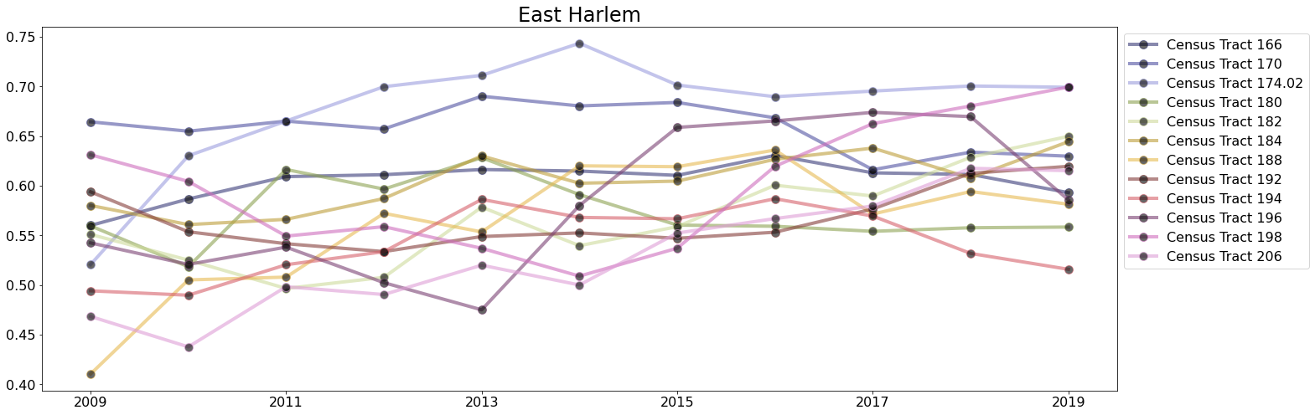
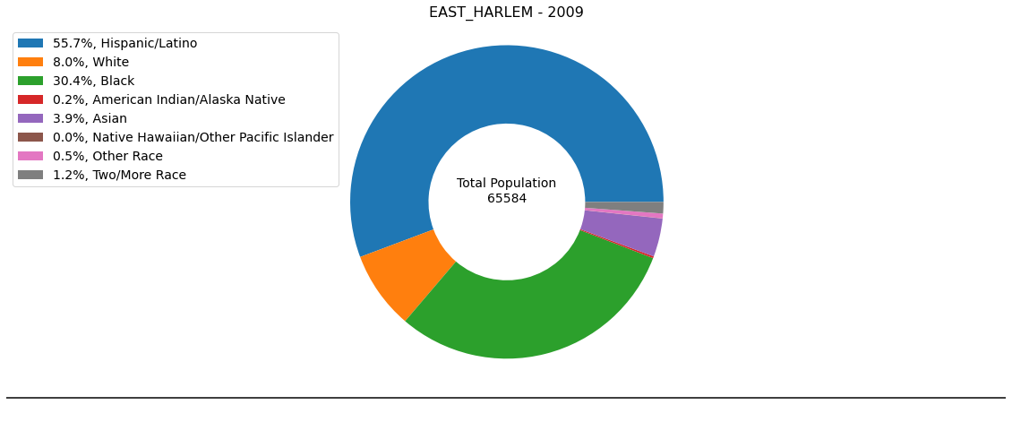
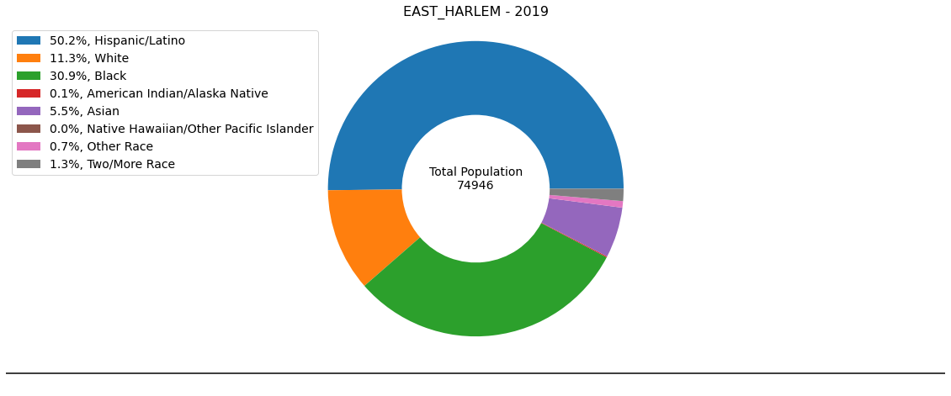
Diversity
Notes:
Diversity Index: We use the Diversity Index (DI) to measure the probability that two people chosen at random will be from different racial and ethnic groups. The DI is bounded between 0 and 1. A value of 0 indicates that everyone in the population has the same racial and ethnic characteristics. A value close to 1 indicates that almost everyone in the population has different racial and ethnic characteristics. We have converted the probabilities into percentages to make them easier to interpret. In this format, the DI tells us the chance that two people chosen at random will be from different racial and ethnic groups. Using the same Diversity Index calculation for 2020 and 2010 redistricting data, the chance that two people chosen at random will be from different racial or ethnic groups has increased to 61.1% in 2020 from 54.9% in 2010. Following are the DI charts that measure the change in diversity index of rezoned neighbourhoods from 2009 to 2019.
Pie Chart: These pie charts show the racial composition of the neighbourhoods for the years 2009 and 2019 helping us compare and analyse the change in demographic compositions on these neighbourhoods in 10 years. The analysis could help us consider how the anticipated racial composition of the new development would influence existing patterns.
Inwood example: There is a distinct difference between the diversity index across all the census tracts in Inwood, but a general upward trend can be seen in the DI for each tract.
Only slight change is seen in the demographic composition of the neighbourhood in ten years with major increase seen in the two or more race category.

Slide 4
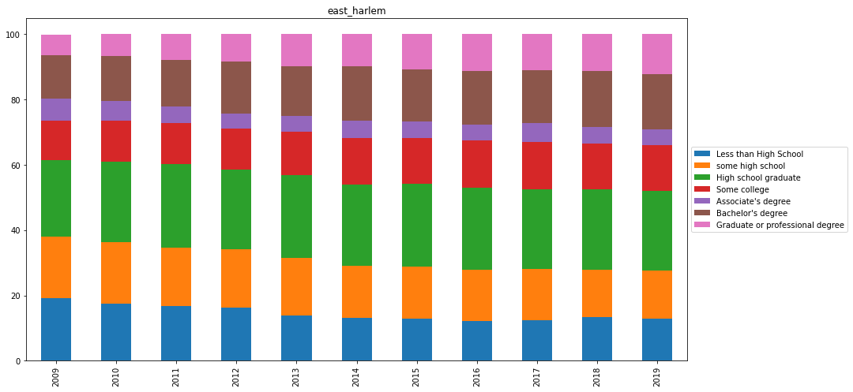
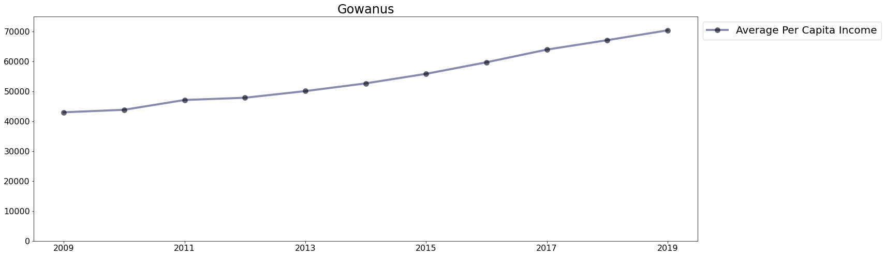
Education & Per Capita Income
Notes:
Here is the education index chart and per capita income chart. We used these to track whether more educated or wealthier residents were pushing out long-time residents
For the Education Graph:
We measured the percentage of each of the different education groups in each neighborhood over 10 years
While general trends can be observed, no statistically significant differences were found across all 7 neighborhoods
Education composition largely remained the same over the 10 year period in each neighborhood
For the per capita income graph:
We measured the change in per capita income over the ten years
We noticed statistically significant trends across most of the neighborhoods, indicating more wealthier residents
The east harlem example shows a trend of increasing graduate’s degree while having a decrease no high school education
Gowanus per capita income increased severely for the past 10 year(like a mother fucker)

Slide 5
Research Findings
Over the 10-year period from 2009 - 2019
Diversity Index
No statistically significant changes except East Harlem
Diversity Composition
Only Gowanus showed statistically significant changes in at least two races
Educational Composition
Only East Harlem and Gowanus showed statistically significant changes in at least two education groups
Per Capita Income
Four neighbourhoods showed statistically significant changes
Notes:
Diversity Index
No neighbourhood showed statistically significant changes except East Harlem, which became more diverse
Diversity Composition
Some neighbourhoods showed statistically significant changes in certain races, but only Gowanus showed changes in at three races
Educational Composition
Some neighbourhoods showed statistically significant changes in certain education levels, but only Gowanus showed changes in four education levels
Per Capita Income
Four neighbourhoods showed statistically significant changes in per capita income: Jerome Avenue, East New York, East Harlem, and Gowanus

Slide 6
Conclusion
We failed to reject our null hypothesis that rezoning in NYC has caused statistically significant changes in three socio-economic characteristics of our studied neighborhoods
We CAN reject the null hypothesis for Per Capita Income, however
4/7 of the neighborhoods studied showed a statistically significant increase
Gowanus is the outlier - Can rezoning turn this around?
Notes:
We failed to reject our null hypothesis that rezoning in NYC has caused statistically significant changes in the socio-economic characteristics of our studied neighborhoods
The only neighborhood with the most statistically significant changes across the four metrics used was Gowanus, which has yet to undergo rezoning
However, it should be noted that the changes observed, especially regarding per capita income and changes in residential education composition, due indicate a general trend towards gentrification,

Slide 7
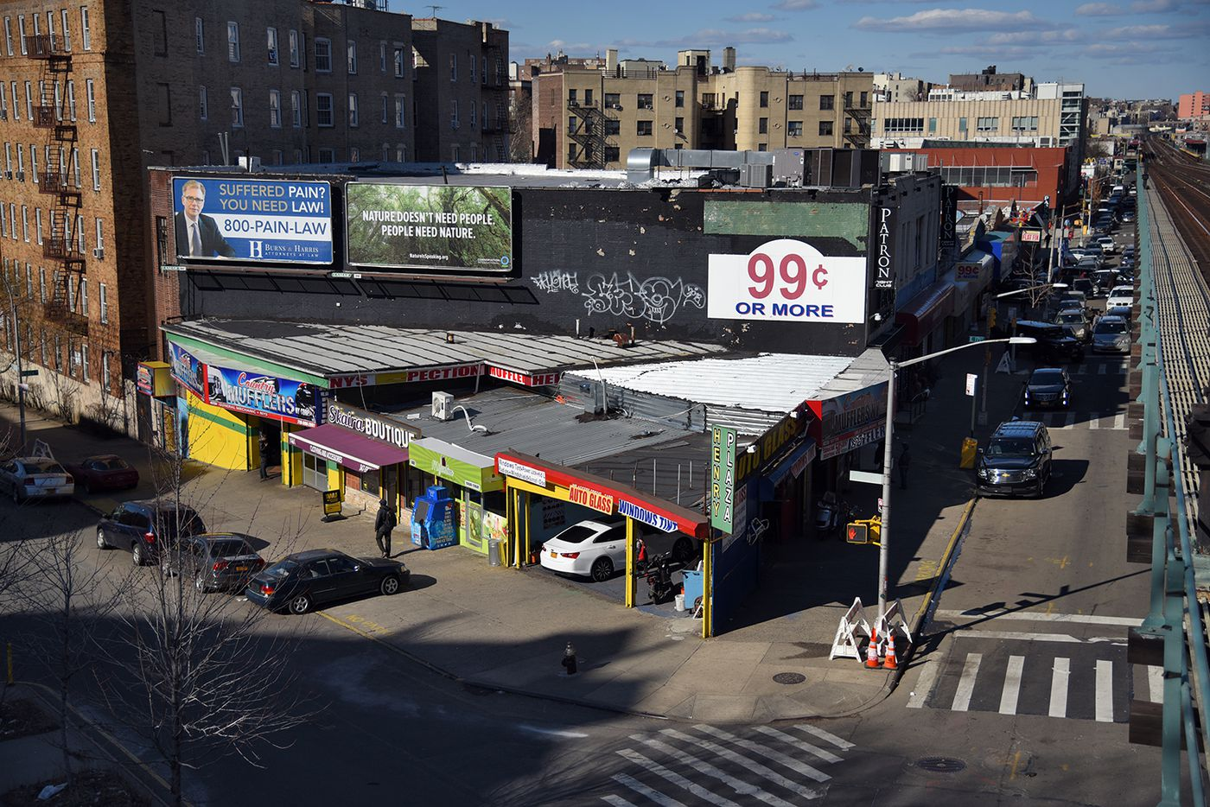
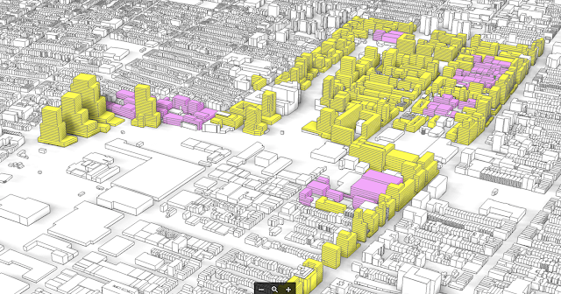
Qualitative Analysis: Jerome Avenue & Gowanus
Jerome
Proposal sought to address issues such as affordable housing
Promises of financial assistance for local businesses never materialized
Property values and rent have skyrocketed in recent years
1/3 of total evictions in the Bronx have come from this area in recent years
Gowanus:
Proposal emphasizes affordable housing and improving diversity
Locals have concerns regarding sewage overflow and believe new residents may exacerbate this issue
30,000 new residents would increase current population by roughly 55%

Slide 8
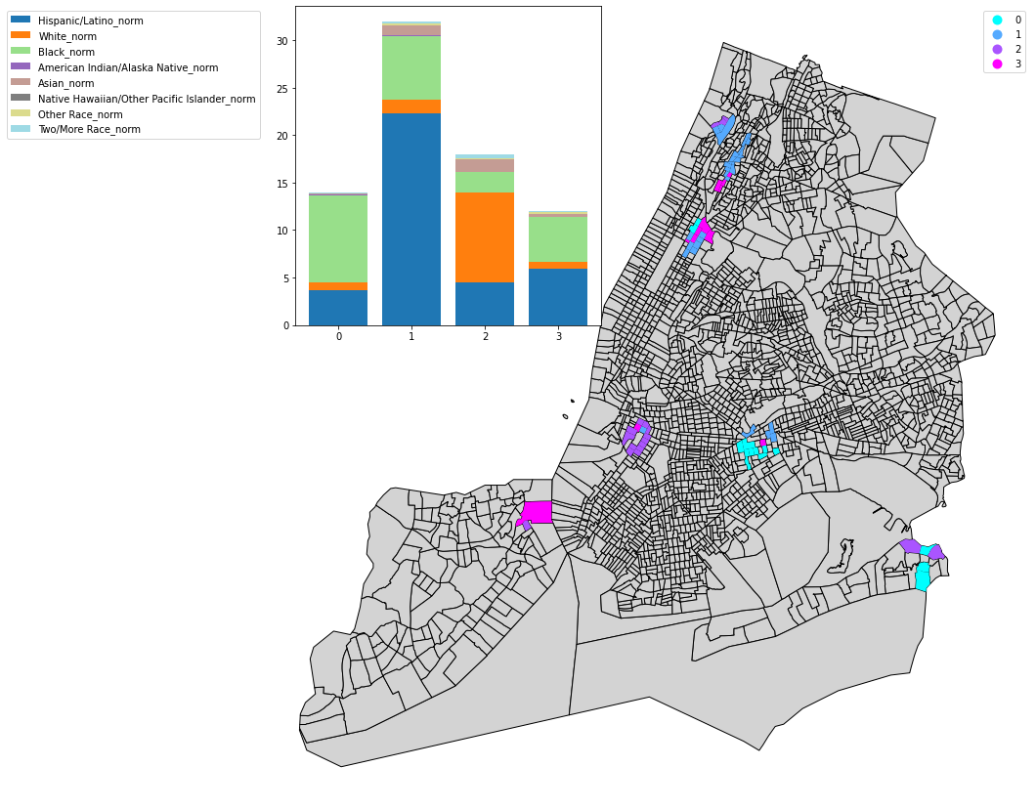
Way Forward and Clustering Analysis
Qualitative ≠ Quantitative
These types of studies should…
Continue to be conducted
Expanded to other areas
Impact on neighborhoods through the lenses of Clustering
What happened?
Who was affected?
How would it help in future studies?

